Slide 1
CS4038
DATA MINING
LECTURE # 04
Spring 2024
FAST – NUCES, CFD CAMPUS
AYESHA LIAQAT
ayesha.liaqat@nu.edu.pk

Slide 2
TODAY’S TOPICS
Data quality issues
Data exploration
Data visualization

Slide 3
DATA QUALITY

Slide 4
DATA QUALITY
Poor data quality negatively affects many data processing efforts
Data mining example: a classification model for detecting people who are loan risks is built using poor data
Some credit-worthy candidates are denied loans
More loans are given to individuals that default

Slide 5
DATA QUALITY
◾
What kinds of data quality problems?
◾
How can we detect problems with the data?
What can we do about these problems?
To be discussed later in the pre-processing lecture.
Examples of data quality problems:
Noise and outliers
Wrong data
Fake data
Missing values
Duplicate data
Notes:
problems due to 1)human error, 2)limitations of measuring devices, or 3)flaws in the data collection process.

Slide 6
NOISE
For objects, noise is an extraneous object
For attributes, noise refers to modification of original values
Examples: distortion of a person’s voice when talking on a poor phone and “snow” on television screen
The figures below show two sine waves of the same magnitude and different frequencies, the waves combined, and the two sine waves with random noise
The magnitude and shape of the original signal is distorted
Notes:
Distortion/addition of spurious objects

Slide 7

OUTLIERS
Outliers are data objects with characteristics that are considerably different than most of the other data objects in the data set
Case 1: Outliers are noise that interferes with data analysis
Case 2: Outliers are the goal of our analysis
Credit card fraud
Intrusion detection
Notes:
1)Data objects 2) values of an attribute that are unusual with respect to the typical values for that attribute
Outliers may be of interest

Slide 8
MISSING VALUES
Reasons for missing values
Information is not collected
(e.g., people decline to give their age and weight)
Attributes may not be applicable to all cases (e.g., annual income is not applicable to children)
Handling missing values
Eliminate data objects or variables
Estimate missing values
Example: time series of temperature
Example: census results
Ignore the missing value during analysis
Notes:
1)Eliminate data objects if objects with missing values are few. A related strategy is to eliminate attributes that have missing values. But be cautious might be that attribute is critical to analysis.
2) For categorical, take most commonly occurring value and for continuous take average of nearest neighbors.
3)During clustering, In pair of points, take value of point in which value is not missing and ignore other one.

Slide 9
DUPLICATE DATA
Data set may include data objects that are duplicates, or almost duplicates of one another
Major issue when merging data from heterogeneous sources
Examples:
Same person with multiple email addresses
Some duplicates are legitimate: twins identical info
Data cleaning/deduplication
Process of dealing with duplicate data issues
Values for 2 duplicate objects would differ so first remove inconsistency and then merge into one object
Notes:
Inconsistent data: city and zip code as if one enters information of zip code for city that is not applicable. Height should not be –ve.
Solution: Doublecheck and correct with other entries through redundant info

Slide 10
HOMEWORK
Read Example 2.1 from Tan’s book to realize the importance of data understanding.

Slide 11
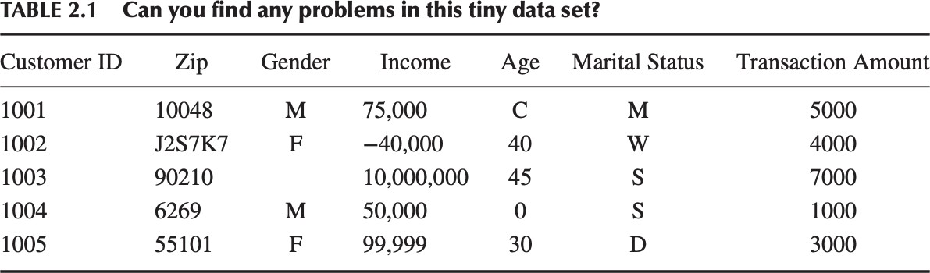
EXAMPLE
It is certainly not possible to scan each entry in a real dataset to identify potential data quality issues.
We need better methods for exploring the data.

Slide 12
DATA EXPLORATION

Slide 13
◾
Data exploration
can aid in selecting the appropriate
preprocessing and data analysis techniques.

Slide 14
BASIC STATISTICAL DESCRIPTIONS OF DATA
Motivation
To better understand the data: central tendency, variation and spread
Data dispersion characteristics
median, max, min, quantiles, outliers, variance, etc.
Notes:
Measures of central tendency: measure the location of middle/center of a distribution. Where most of the values fall. Mean,median,mode,midrange
Data dispersion measures: Range, quartiles, IQR, 5 No. Summary, boxplots, variance, standard deviation

Slide 15
FREQUENCIES AND MODE
Useful for unordered categorical values.
Frequency: the measure of count with which each value occurs in data
₌ 𝑛𝑢𝑚𝑏𝑒𝑟 𝑜𝑓 𝑜𝑏𝑗𝑒𝑐𝑡𝑠 𝑤𝑖𝑡ℎ 𝑎𝑡𝑡𝑟𝑖𝑏𝑢𝑡𝑒 𝑣𝑎𝑙𝑢𝑒 𝑣_{𝑖}
𝑓𝑟𝑒𝑞𝑢𝑒𝑛𝑐𝑦 𝐯
𝐢
𝑚
Mode: value that has the highest frequency

Slide 16
PERCENTILES
For ordered data, it is more useful to consider the percentiles of a set of values.
Percentile is a measure used in statistics indicating the value below which a given percentage of observations in a group of observations fall.
For example, the 50th percentile is the score below which 50% of the observations may be found.

Slide 17
MEASURING THE CENTRAL TENDENCY
For continuous data, two most commonly used summary statistics are: mean and median.
Mean (algebraic measure) (sample vs. population):
∑ ^{w}i ^{x}i
n
x = ¹ ∑ x
μ = ^{∑ x}
n
n
i =1
i
N
Weighted arithmetic mean:
_{x =} i=1
Note: n is sample size and N is population size.
n
∑ ^{w}i
i=1
Trimmed mean: chopping extreme values from top and bottom with some percentage
Median:
A middle value when inputs are sorted in ascending order
Middle value if odd number of values, or average of the middle two values otherwise
Separates higher half of data from lower half
Useful for skewed(asymmetric) data
Mode: (some may prefer to use mode for continuous data). No mode or multimodal
A value occurring with the highest frequency
E.g…. Favorite color, preferred mode of transportation, NLP
Notes:
Mean: useful measure of center. Weight reflects significance, importance.
Mean is sensitive to outliers. Extreme values can corrupt the mean. As mean of 6,7,7,4,5,5 and 6,7,7,4,5,100 are different.
Trimmed mean is useful where outliers are present in dataset. Sort data and trim some% from both ends and then take mean
Median is useful when outliers are present in data but does not fully capture the spread of data as only picks middle value. Not good for symmetric data.
Median also applies to ordinal. For odd numbers, middle value. For even median is not unique.
Midrange= (min + max) /2

Slide 18
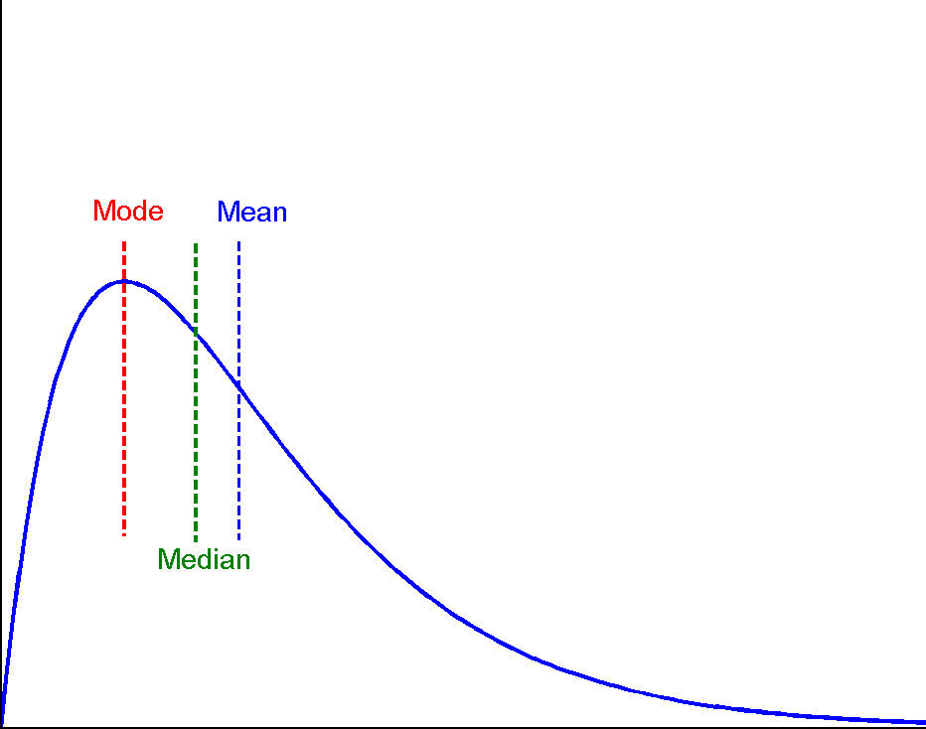
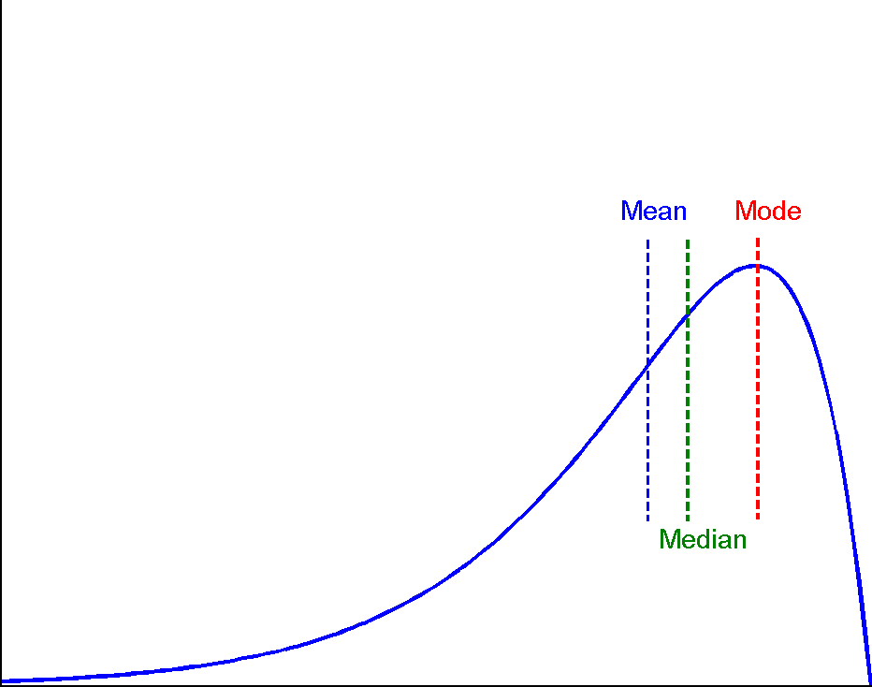

SYMMETRIC VS. SKEWED DATA
Median, mean and mode of symmetric, positively and negatively skewed data

Slide 19
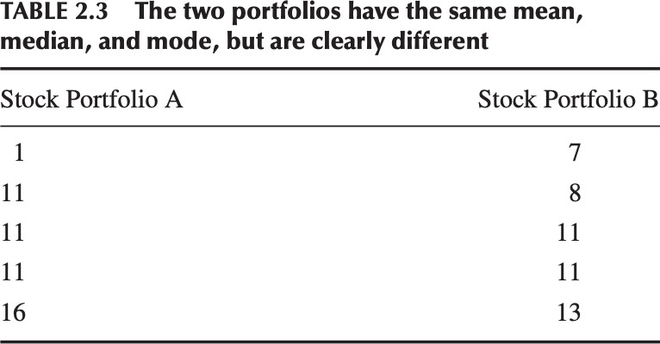
MEASURING THE CENTRAL TENDENCY
Mean = 10
Median = 11
Mode = 11
Thus, measures of center do not provide us with a complete picture.

Slide 20
MEASURING DATA DISPERSION/SPREAD/VARIABILITY
Another set of commonly used summary statistics for continuous data are those that measure the dispersion or spread of a set of values.
These indicate if the attribute values are widely spread out or concentrated around the center (or mean).
Notes:
Range, Quartile, IQR, variance, Standard deviation: spread of numeric data
5 No. summary, Boxplot: outliers detection

Slide 21


MEASURING DATA DISPERSION/SPREAD
Range: the simplest measure of spread
𝑟𝑎𝑛𝑔𝑒 𝐱 = max 𝑥 − min 𝑥
Variance and standard deviation (sample: s, population: σ)
Variance: (algebraic, scalable computation)
How much datapoints differ from mean
_{s2 =} 1 ∑
1
n −1
1
_{σ 2 =} 1 ∑
1
N
n
n
n
n
n
∑
i ∑ i
∑
2
2
(x − μ ) =
2
(x − x) =
[
x − ( x )² ]
2
x − μ
2
n −1
i=1
i
i=1
n
i=1
N
i=1
i
i=1
i
Standard deviation s (or σ) is the square root of variance s² (or σ²)
Most values lie within two SDs of the mean.
Notes:
Larger var/std dev-→ more spread/dispersed. Both measure avg distance of each data point from mean.
Sensitive to outliers
Std dev is interpreted in the units of original data while variance is squared distance from mean.

Slide 22
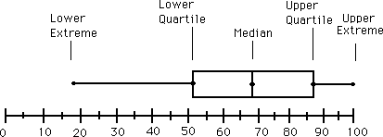
MEASURING DATA DISPERSION/SPREAD
Quartiles, outliers and boxplots
Quartiles: Q₁ (25th percentile), Q₃ (75th percentile)
Inter-quartile range: IQR = Q₃ – Q₁
Five number summary: min, Q₁, median,Q₃, max
Boxplot: ends of the box are the quartiles; median is marked; add whiskers, and plot outliers individually. To visualize a distribution
Outlier: usually, a value lower than Q1-1.5 x IQR OR higher than Q3+1.5 x IQR
Notes:
Quantiles: points that partition data into equal sized units like Quartiles, percentiles
Quartiles: divide dataset into 4 equal parts each containing 25%

Slide 23
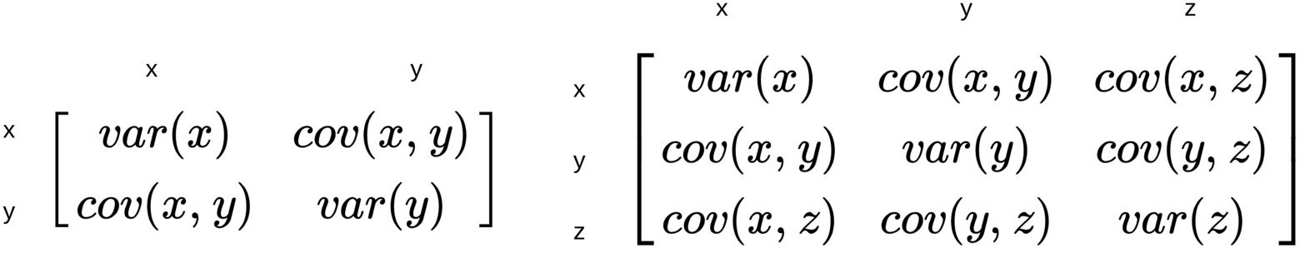
MULTIVARIATE SUMMARY STATISTICS
Data that consists of several attributes is known as multivariate data.
Spread of each attribute can be computed separately using the techniques discussed already.
However, for data with continuous variables, spread of the data is most commonly captured by the Covariance Matrix (S), whose ij^{th} entry s_{ij} is the covariance of the i^{th} and j^{th} attributes of the data, i.e. s_{ij} = covariance (x_{i}, x_{j})
Notes:
How two variable change together. +ve covar:variables move in same direction. –ve covar: var move in opposite direction

Slide 24
DATA VISUALIZATION

Slide 25
DATA VISUALIZATION
Why data visualization?
Gain insight into an information space by mapping data onto graphical primitives
Provide qualitative overview of large data sets
Search for patterns, trends, structure, irregularities, relationships among data
Help find interesting regions and suitable parameters for further quantitative analysis
Provide a visual proof of computer representations derived
Possible categorization of visualization methods:
Number of attributes involved
Whether the data has some spatial characteristics, hierarchical or graph structure
Type of attributes involved
Type of application

Slide 26
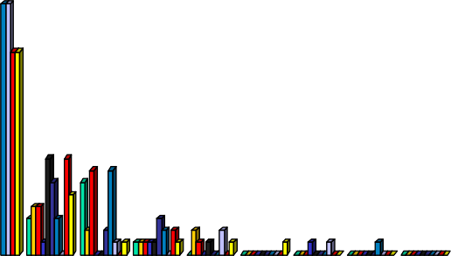
HISTOGRAM ANALYSIS
40
35
30
25
20
15
10
5
Histogram: Graph display of tabulated frequencies, shown as bars
It shows what proportion of cases fall into each of several categories
Differs from a bar chart in that it is the area of the bar that denotes the value, not the height as in bar charts, a crucial distinction when the categories are not of uniform width
The categories are usually specified as non- overlapping intervals of some variable.The categories (bars) must be adjacent
0
10000
30000
50000
70000
90000

Slide 27
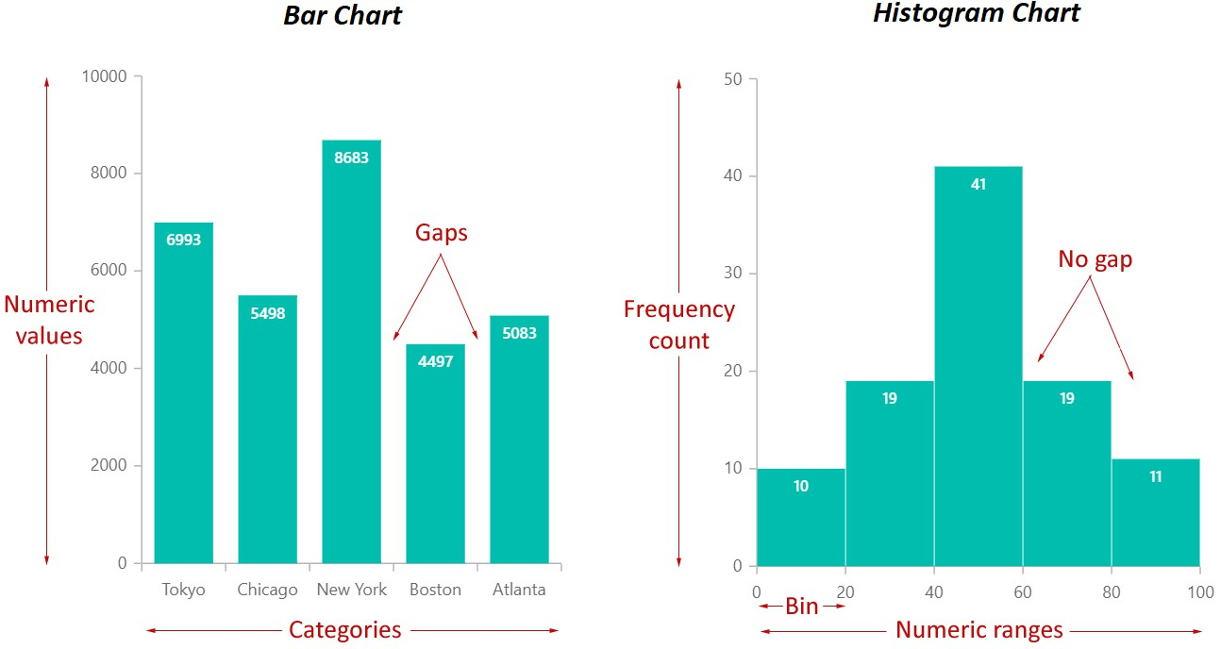
BAR CHART VS. HISTOGRAM CHART
https://www.syncfusion.com/blogs/wp-content/uploads/2019/11/Bar-chart-versus-histogram-chart-elements-representation.png
Notes:
Bar chart used to compare categorical data while histogram used to visualize distribution of continuous data

Slide 28
HISTOGRAMS OFTEN TELL MORE THAN BOXPLOTS
The two histograms shown on the left may have the same boxplot representation
The same values for: min, Q1, median, Q3, max
But they have rather different data distributions
Notes:
Detailed view of distr, shape of distr,data density,outlier detection

Slide 29
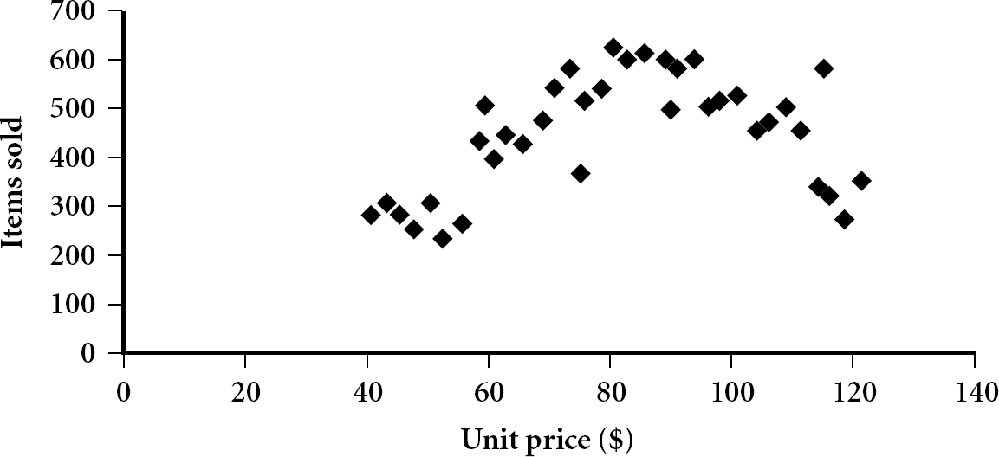
SCATTER PLOT
Provides a first look at bivariate data to see clusters of points, outliers, etc.
Each pair of values is treated as a pair of coordinates and plotted as points in the plane
Notes:
For pattern/trend between two numeric attributes

Slide 30
POSITIVELY AND NEGATIVELY CORRELATED DATA
The left half fragment is positively correlated
The right half is negative correlated

Slide 31
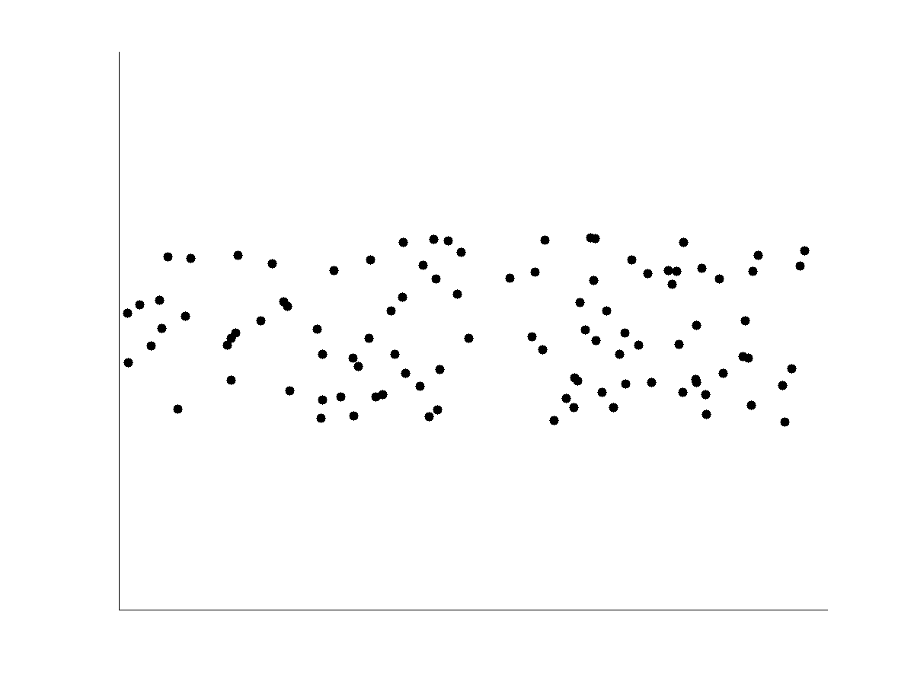
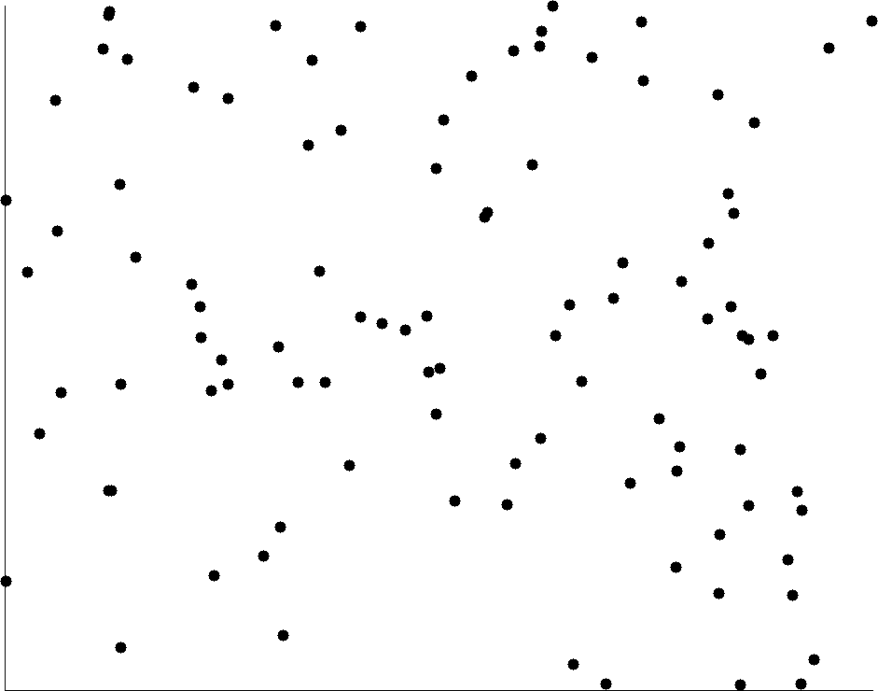
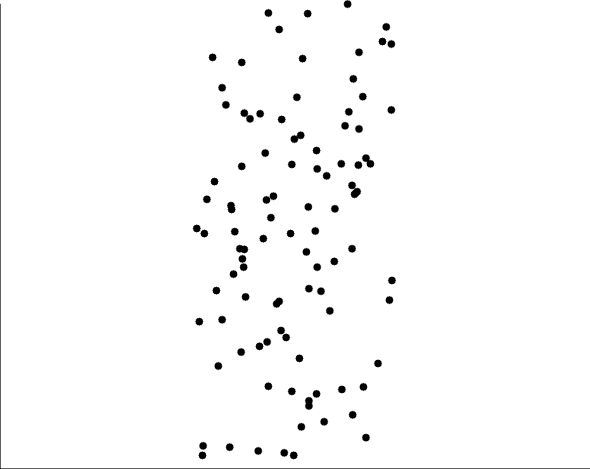
UNCORRELATED DATA

Slide 32
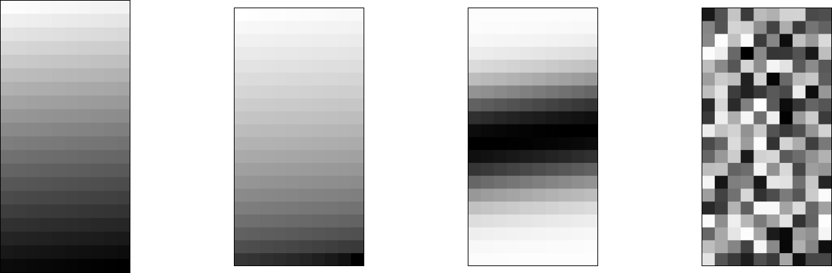
PIXEL-ORIENTED VISUALIZATION TECHNIQUES
For a data set of m dimensions, create m windows on the screen, one for each dimension
The m dimension values of a record are mapped to m pixels at the corresponding positions in the windows
The colors of the pixels reflect the corresponding values
(a) Income
(b) Credit
Limit
(c) transaction volume
(d) age
Notes:
Credit-limit inc as income inc
Cust whose credit-limit in the middle range are more likely to purchase more from store

Slide 33
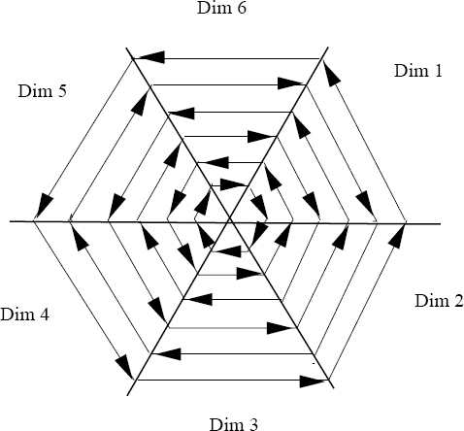
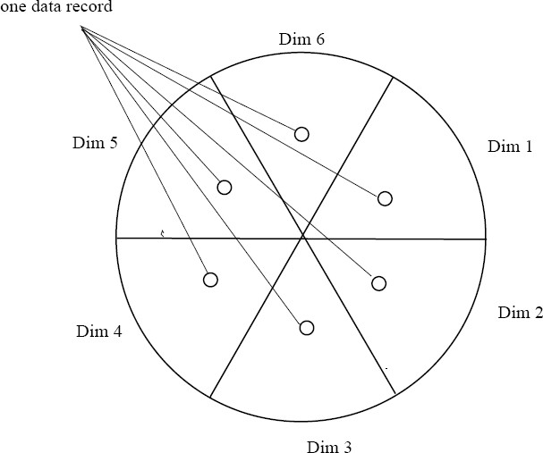
LAYING OUT PIXELS IN CIRCLE SEGMENTS
To save space and show the connections among multiple dimensions, space filling is often done in a circle segment
(a) Representing a data record in circle segment
(b) Laying out pixels in circle segment

Slide 34
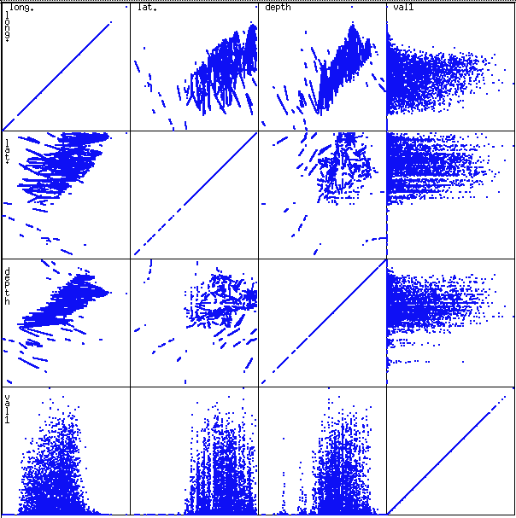
SCATTERPLOT MATRICES
Used by ermission of M. Ward, Worcester Polytechnic Institute
Matrix of scatterplots (x-y-diagrams) of the k-dim. data [total of (k2/2-k) scatterplots]
37

Slide 35
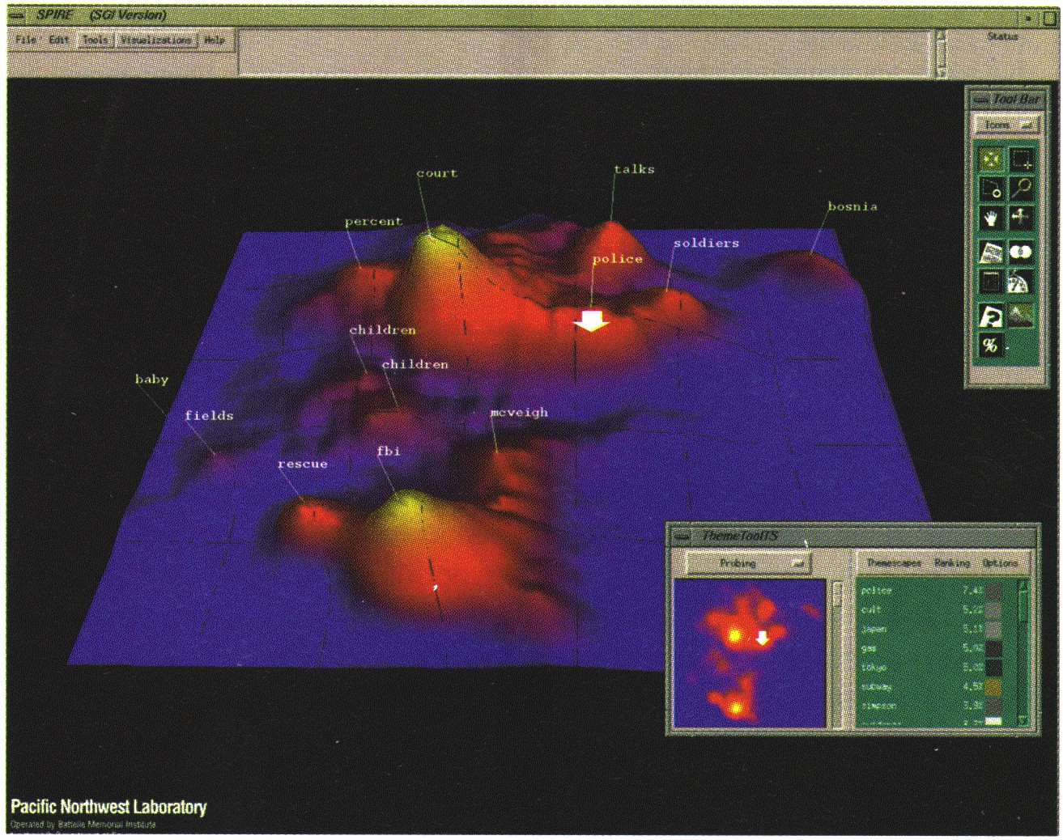
LANDSCAPES
Used by permission of B. Wright, Visible Decisions Inc.
news articles visualized as a landscape
Visualization of the data as perspective landscape
The data needs to be transformed into a (possibly artificial) 2D spatial representation which preserves the characteristics of the data

Slide 36
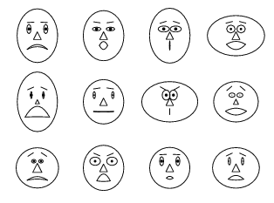
CHERNOFF FACES
A way to display variables on a two-dimensional surface, e.g., let x be eyebrow slant, y be eye size, z be nose length, etc.
The figure shows faces produced using 10 characteristics--head eccentricity, eye size, eye spacing, eye eccentricity, pupil size, eyebrow slant, nose size, mouth shape, mouth size, and mouth opening): Each assigned one of 10 possible values, generated using Mathematica (S. Dickson)
REFERENCE: Gonick, L. and Smith, W. The Cartoon Guide to Statistics. New York: Harper Perennial, p. 212, 1993
Weisstein, Eric W. "Chernoff Face." From MathWorld--A Wolfram Web Resource. mathworld.wolfram.com/ChernoffFace.html

Slide 37











DIMENSIONAL STACKING
attribute 4
attribute 2
attribute 3
attribute 1
Partitioning of the n-dimensional attribute space in 2-D subspaces, which are ‘stacked’ into each other
Partitioning of the attribute value ranges into classes. The important attributes should be used on the outer levels.
Adequate for data with ordinal attributes of low cardinality
But, difficult to display more than nine dimensions
Important to map dimensions appropriately

Slide 38
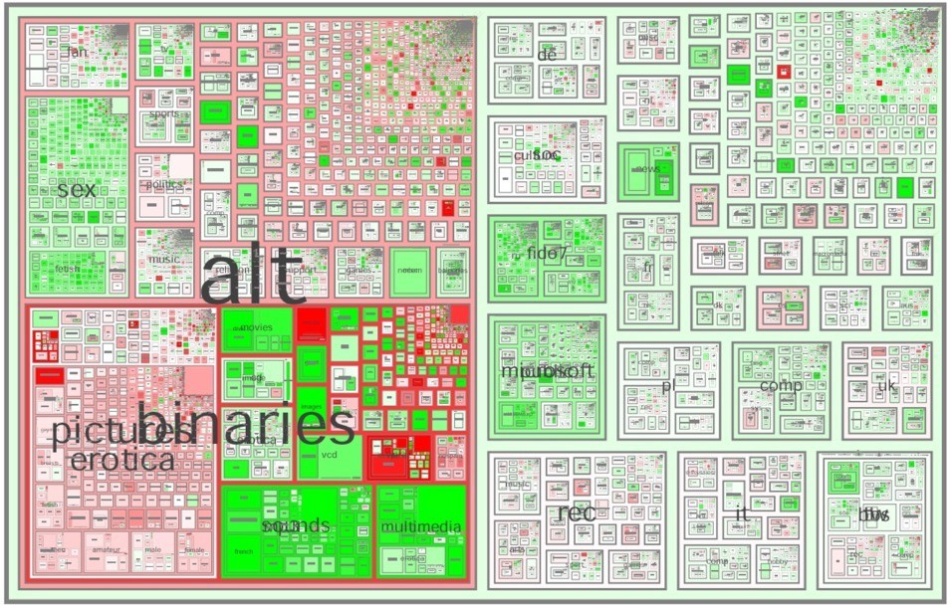
TREE-MAP
Screen-filling method which uses a hierarchical partitioning of the screen into regions depending on the attribute values
The x- and y-dimension of the screen are partitioned alternately according to the attribute values (classes)
Ack.: http://www.cs.umd.edu/hcil/treemap- history/all102001.jpg
MSR Netscan Image

Slide 39
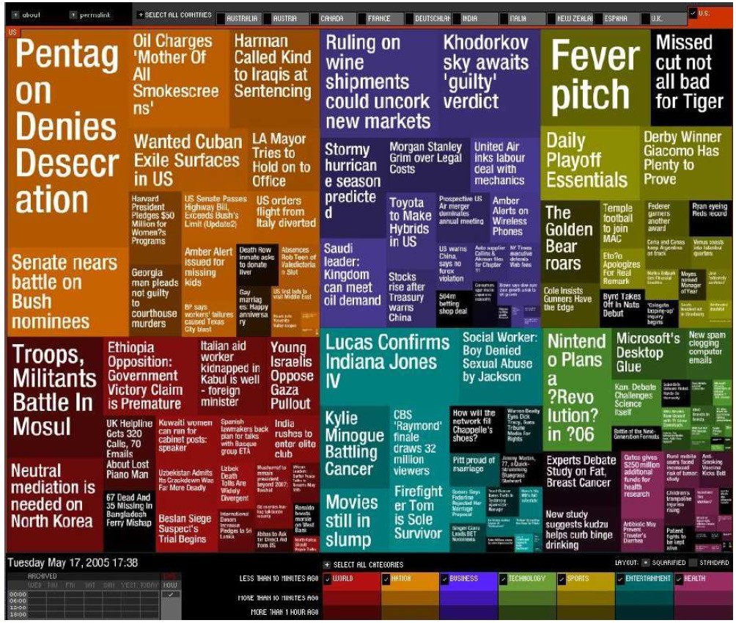
VISUALIZING COMPLEX DATA AND RELATIONS
Visualizing non-numerical data: text and social networks
Tag cloud: visualizing user- generated tags
The importance of tag is represented by font size/color
Besides text data, there are also methods to visualize relationships, such as visualizing social networks
Newsmap: Google News Stories in 2005

Slide 40
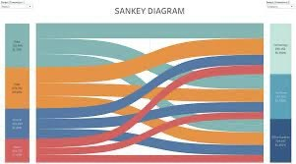
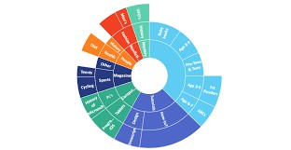
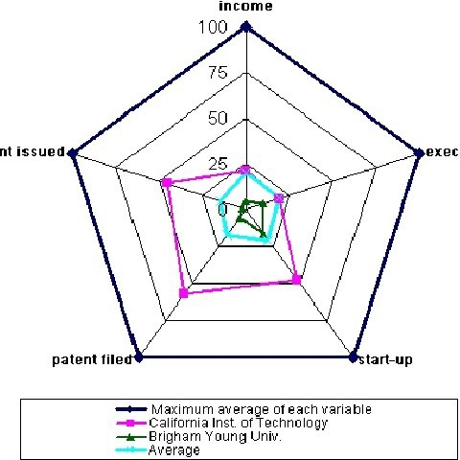
AND MANY MORE…
◾
And many more…
Sankey chart
Sunburst chart
Radio chart

Slide 41
READING MATERIAL
Chapter 2 & 3:Tan, Steinbach & Kumar
Chapter 2: Han, Kamber & Pei
Chapter 2: Daniel T. Larose

